Slide 1
Ray Diagrams Notes

Slide 2



Lenses change the paths of light.

Slide 3

Lenses
A light ray bends as it enters glass and bends again as it leaves.
Light passing through glass of a certain shape can form an image that appears larger, smaller, closer, or farther than the object being viewed.

Slide 4
Converging and Diverging Lenses
A lens forms an image by bending parallel rays of light that pass through it.
A lens is a piece of glass or plastic that refracts light.

Slide 5
Converging and Diverging Lenses
A converging lens, also known as a convex lens, is thicker in the middle, causing rays of light that are initially parallel to meet at a single point.
A diverging lens, also known as a concave lens, is thinner in the middle, causing the rays of light to appear to originate from a single point.

Slide 6
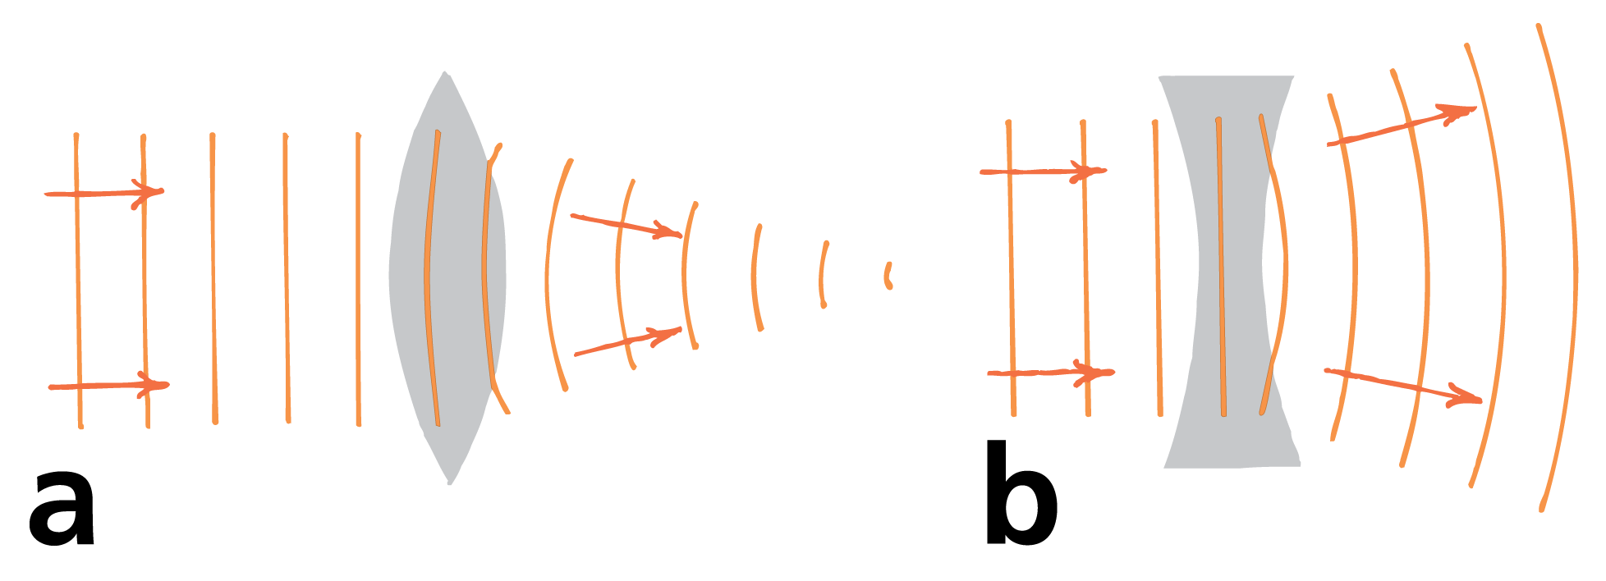
Converging and Diverging Lenses
Wave fronts travel more slowly in glass than in air.
In the converging lens, the wave fronts are hindered more through the center of the lens, and the light converges.
In the diverging lens, the waves are hindered more at the edges, and the light diverges.

Slide 7
Key Features of Lenses
The principal axis of a lens is the line joining the centers of curvature of its surfaces.
For a converging lens, the focal point is the point at which a beam of light parallel to the principal axis converges.
The focal plane is a plane perpendicular to the principal axis that passes through either focal point of a lens.

Slide 8
Converging Lenses
For a converging lens, any incident parallel beam converges to a point on the focal plane.
A lens has two focal points and two focal planes.
When the lens of a camera is set for distant objects, the film is in the focal plane behind the lens in the camera.

Slide 9
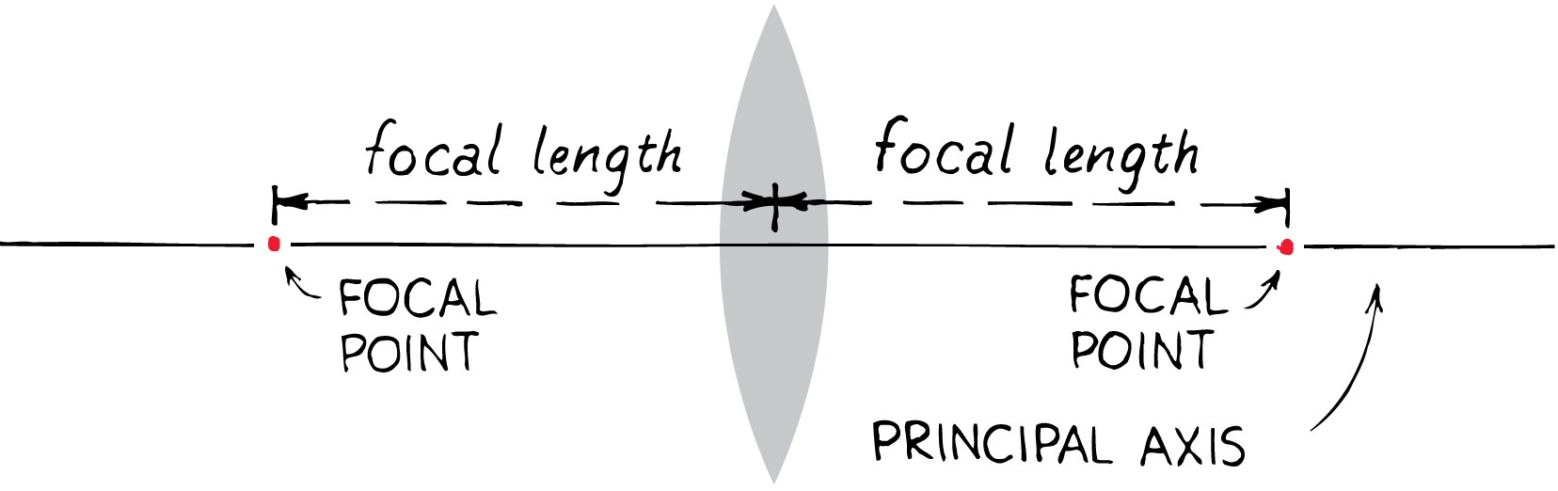
Converging Lenses
The key features of a converging lens include the principal axis, focal point, and focal plane.

Slide 10
Diverging Lenses
For a diverging lens, an incident beam of light parallel to the principal axis is diverged so that the light appears to originate from a single point.
The focal length of a lens, whether converging or diverging, is the distance between the center of the lens and its focal point.
When the lens is thin, the focal lengths on either side are equal, even when the curvatures on the two sides are not.

Slide 11
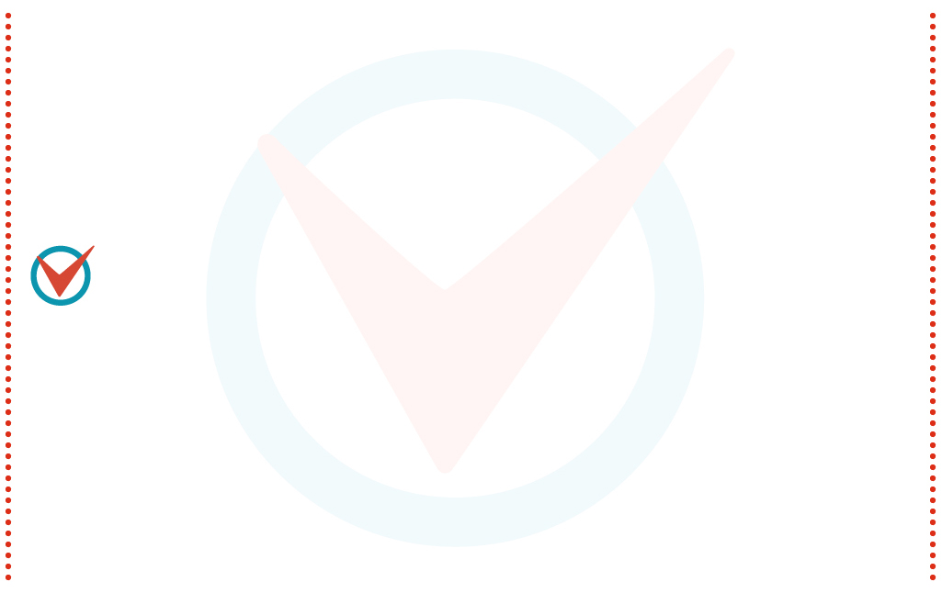
Image Formation by a Lens
The type of image formed by a lens depends on the shape of the lens and the position of the object.

Slide 12
Image Formation by a Lens
With unaided vision, a far away object is seen through a relatively small angle of view.
When you are closer, the object is seen through a larger angle of view.
Magnification occurs when the use of a lens allows an image to be observed through a wider angle than would be observed without the lens.
A magnifying glass is simply a converging lens that increases the angle of view and allows more detail to be seen.

Slide 13
Images Formed by Converging Lenses
When you use a magnifying glass, you hold it close to the object you wish to see magnified.
A converging lens will magnify only when the object is between the focal point and the lens.
The magnified image will be farther from the lens than the object and right-side up.

Slide 14
Images Formed by Converging Lenses
If a screen were placed at the image distance, no image would appear on the screen because no light is actually directed to the image position.
The rays that reach your eye, however, behave as if they came from the image position, so the image is a virtual image.

Slide 15
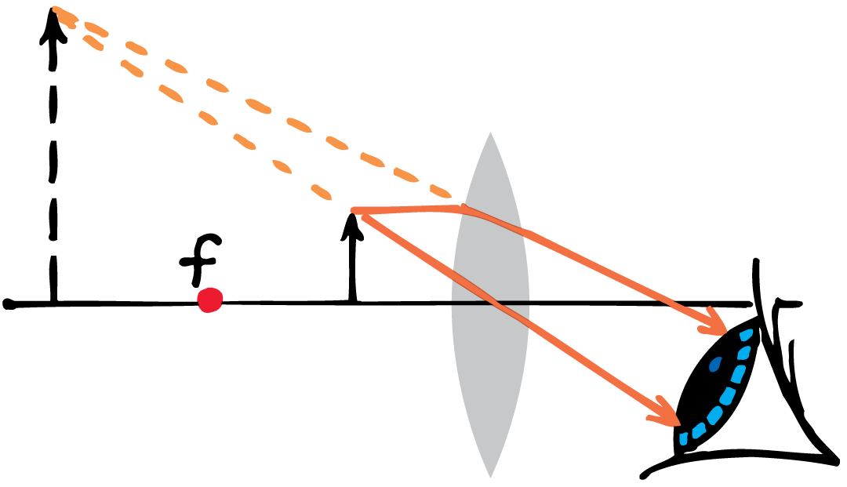
Images Formed by Converging Lenses
A converging lens can be used as a magnifying glass to produce a virtual image of a nearby object.

Slide 16
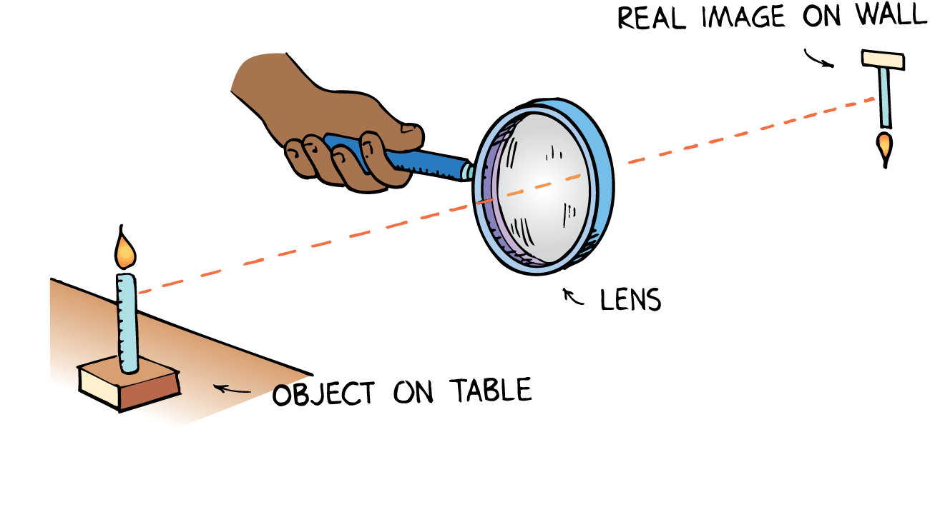
Images Formed by Converging Lenses
When the object is beyond the focal point of a converging lens, light converges and can be focused on a screen.
An image formed by converging light is called a real image.
A real image formed by a single converging lens is upside down.
Converging lenses are used for projecting pictures on a screen.

Slide 17
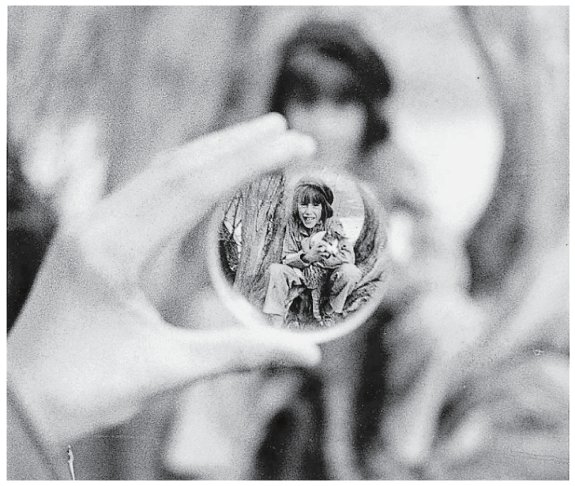
Images Formed by Diverging Lenses
When a diverging lens is used alone, the image is always virtual, right-side up, and smaller than the object.
It makes no difference how far or how near the object is.
A diverging lens is often used for the viewfinder on a camera.

Slide 18
Constructing Images Through Ray Diagrams
The size and location of the object, its distance from the center of the lens, and the focal length of the lens are used to construct a ray diagram.

Slide 19
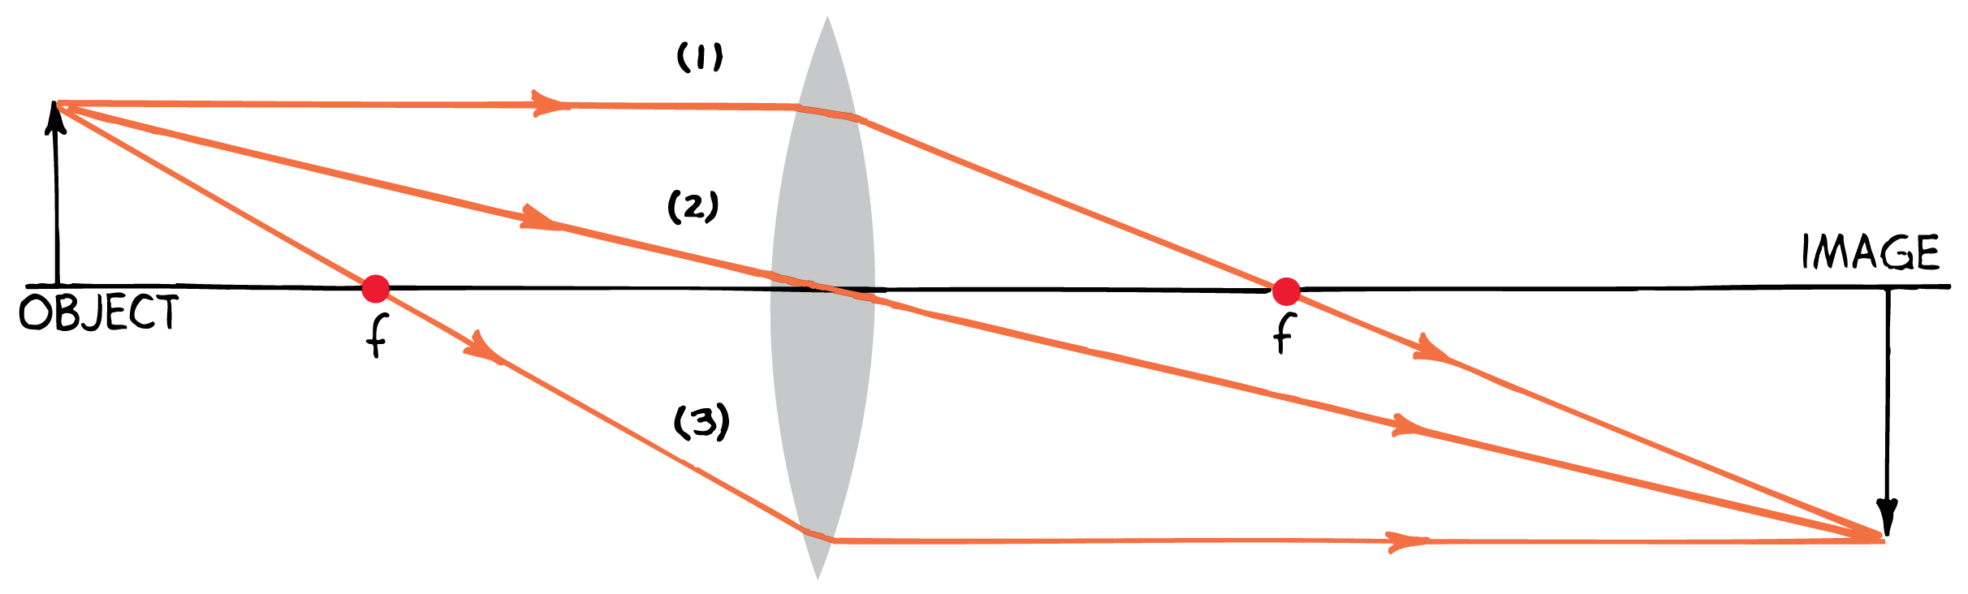
Constructing Images Through Ray Diagrams
Ray diagrams show the principal rays that can be used to determine the size and location of an image.
The size and location of the object, distance from the center of the lens, and the focal length are used to construct the ray diagram.

Slide 20
Constructing Images Through Ray Diagrams
An arrow is used to represent the object.
For simplicity, one end of the object is placed right on the principal axis.

Slide 21
Constructing Images Through Ray Diagrams
The Three Principal Rays
To locate the position of the image, you only have to know the paths of two rays from a point on the object.
Any point except for the point on the principal axis will work, but it is customary to choose a point at the tip of the arrow.

Slide 22
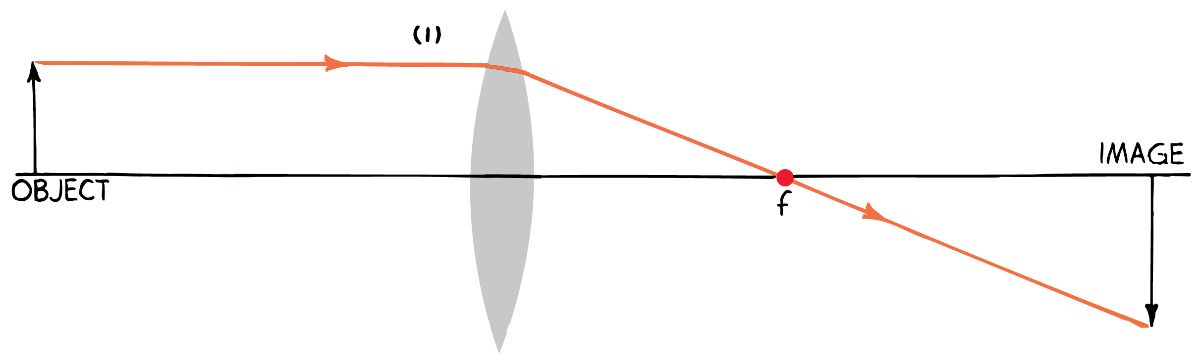
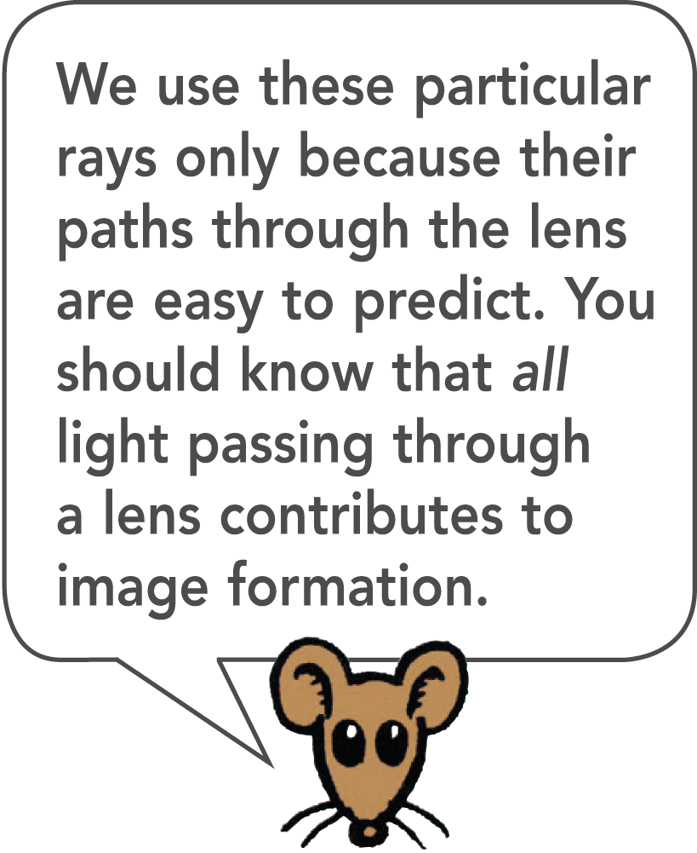
Constructing Images Through Ray Diagrams
The Three Principal Rays
A ray parallel to the principal axis will be refracted by the lens to the focal point.

Slide 23
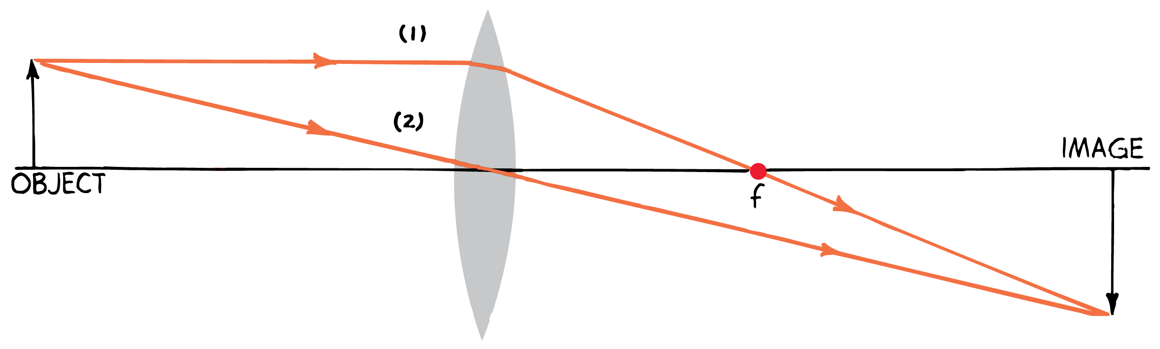
Constructing Images Through Ray Diagrams
The Three Principal Rays
A ray parallel to the principal axis will be refracted by the lens to the focal point.
A ray will pass through the center with no appreciable change in direction.

Slide 24
Constructing Images Through Ray Diagrams
The Three Principal Rays
A ray parallel to the principal axis will be refracted by the lens to the focal point.
A ray will pass through the center with no appreciable change in direction.
A ray that passes through the focal point in front of the lens emerges from the lens parallel to the principal axis.

Slide 25
Constructing Images Through Ray Diagrams
The image is located where the three rays intersect. Any two of these three rays is sufficient to locate the relative size and location of the image.

Slide 26
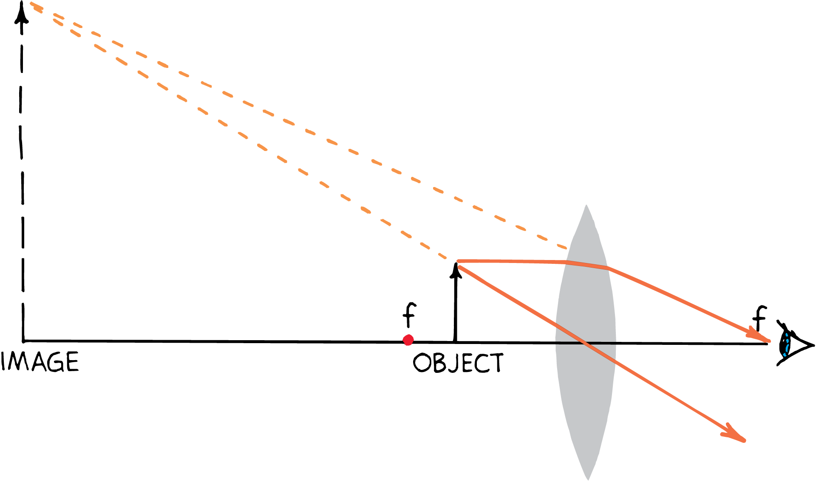
Constructing Images Through Ray Diagrams
Location of object
If the distance from the lens to the object is less than the focal length, the rays diverge as they leave the lens.
The rays of light appear to come from a point in front of the lens.
The location of the image is found by extending the rays backward to the point where they converge.
The virtual image that is formed is magnified and right-side up.

Slide 27
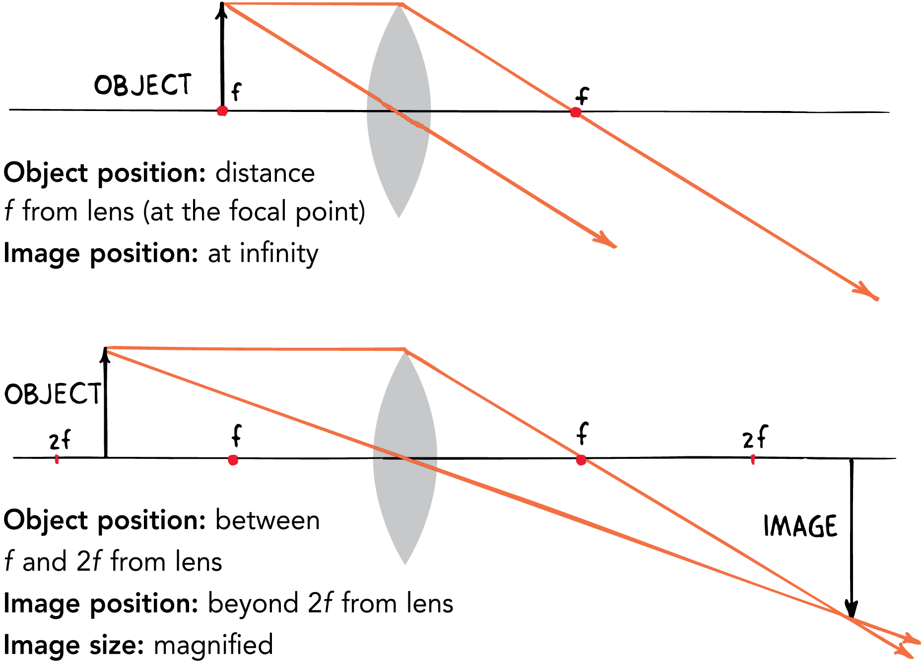
Constructing Images Through Ray Diagrams
For a converging lens, as an object, initially at the focal point, is moved away from the lens along the principal axis, the image size and distance from the lens changes.
For a converging lens, if the object is not located between the focal point and the lens, the images that are formed are real and inverted.

Slide 28
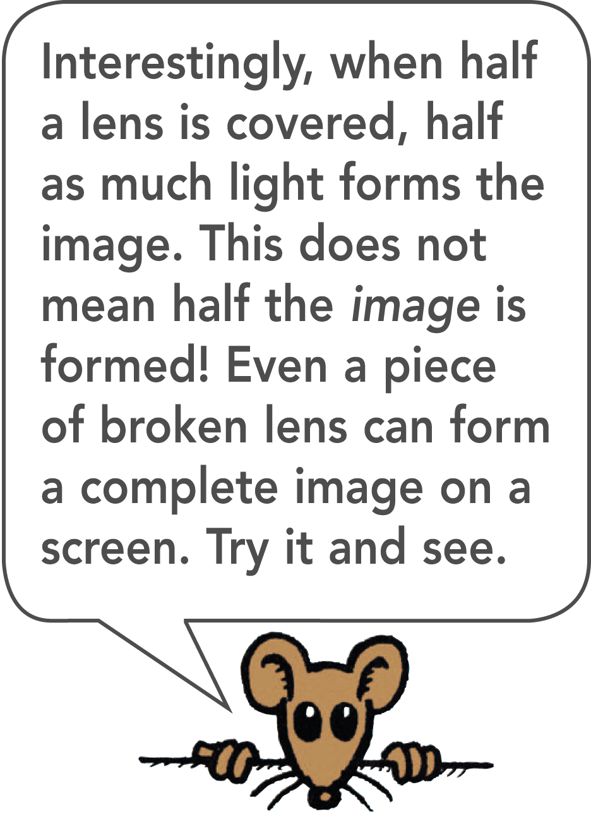
Constructing Images Through Ray Diagrams RULES
The three rays useful for the construction of a ray diagram are:
A ray parallel to the principal axis that passes through the focal point on the opposite side.
A ray passing through the center of the lens that is undeflected.
A ray through the focal point in front of the lens that emerges parallel to the principal axis after refraction by the lens.

Slide 29
Constructing Images Through Ray Diagrams
Diverging Lenses
The method of drawing ray diagrams applies to diverging lenses.
A ray parallel to the principal axis from the tip of the arrow will be bent by the lens as if it had come from the focal point.
A ray through the center goes straight through.
A ray heading for the focal point on the far side of the lens is bent so that it emerges parallel to the axis of the lens.

Slide 30
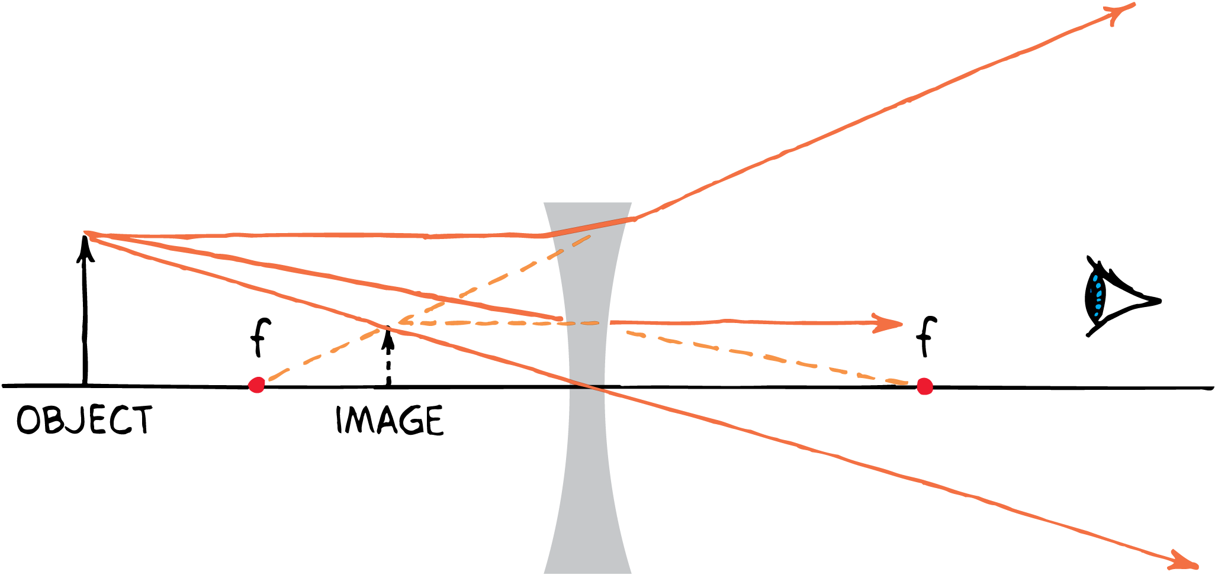
Constructing Images Through Ray Diagrams
Diverging Lenses
On emerging from the lens, the three rays appear to come from a point on the same side of the lens as the object.
This is the position of the virtual image. The image is nearer to the lens than the object.
The image formed by a diverging lens is always virtual, reduced, and right-side up.

Slide 31
Image Formation Summarized
A converging lens forms either a real or a virtual image. A diverging lens always forms a virtual image.

Slide 32
Image Formation Summarized
For a converging lens, when the object is within one focal length of the lens, the image is then virtual, magnified, and right-side up.
When the object is beyond one focal length, a converging lens produces a real, inverted image.
If the object is close to (but slightly beyond) the focal point, the image is far away.
If the object is far from the focal point, the image is nearer.
In all cases where a real image is formed, the object and the image are on opposite sides of the lens.

Slide 33
Image Formation Summarized
When the object is viewed with a diverging lens, the image is virtual, reduced, and right-side up.
This is true for all locations of the object.
In all cases where a virtual image is formed, the object and the image are on the same side of the lens.

